Slide 1

JPA FOR NoSQL
Ways for using JPA and NoSQL together. Contribution for Hibernate OGM project.
APRIL 3, 2017

Slide 2

SERGEY CHERNOLYAS
I have been using Java technologies for 15+ years. During the period, I have got six certificates (4 from Sun/Oracle and 2 from IBM). Also, I got part in several big projects for russian and international companies, like VTB24 (VTB Group), TouchBank (OTP Group).
I have got part in contribution for open source projects since 2016.
SERGEY CHERNOLYAS
Lead Software Engineer

Slide 3
SUBTOPICS
JPA for NoSQL: Why and How?
Hibernate OGM presentation
OrientDB presentation
My contribution to Hibernate OGM project (Integration module for OrientDB)
Notes:
Today, I am going to talk about using JPA in NoSQL world, to present projects Hibernate OGM, OrientDB and my integration module that lets use JPA and OrientDB together.
My speech consists of four subtopics.
I demonstrate examples of using Hibernate OGM with several NoSQL storages. Also I demonstrate OrientDB and my integration module for Hibernate OGM for OrientDB .
Lets start

Slide 4
JPA for NoSQL: Why and How?

Slide 5
JPA for NoSQL: Why and How?
Standard way for declare and describe domain model
Common way for working with entities
One way for working with different storages
Notes:
One of first implementations of ORM (Object-Relation-Mapping) was Entity Beans from EJB2 (specification 1.1 from 1999). So, You can see that idea of ORM for relational databases is old enough. But … What is reasons of it? Everyone knows that relational databases has standard language (SQL) and standard interface for database driver (JDBC). However, ORM tools as middle level have been progressing.
Why?
I think that main reasons are :
Firstly, ORM provides a general way for describe domain model. And secondly, ORM takes care of working with database.
JPA as the inheritor of ORM ideas is the most used standard since 2006 (JPA 1.0) . The current version of the specification is 2.1. Now, JPA has several implementations such as Hibernate ORM, EclipseLink and Apache OpenJPA, these implementations have had production status for many years.
So, everything is okey in world of relational databases.
But what about the world of NoSQL storages? Can we use the same ways with NoSQL storages? Can we use the same application with MongoDB and Apache Casandra?

Slide 6

Hibernate OGM presentation

Slide 7
Introduction the project
Main goals
Main achievements
Notes:
The project “Hibernate OGM” started in 2011.
Its main goal is to provide one standard access for all NoSQL storages. Its target specification is JPA 2.1
Now, achievements of the project are :
supporting the most of used types of storages
supporting the eight most popular storages
implementing the most of requirements of JPA 2.1 specification

Slide 8
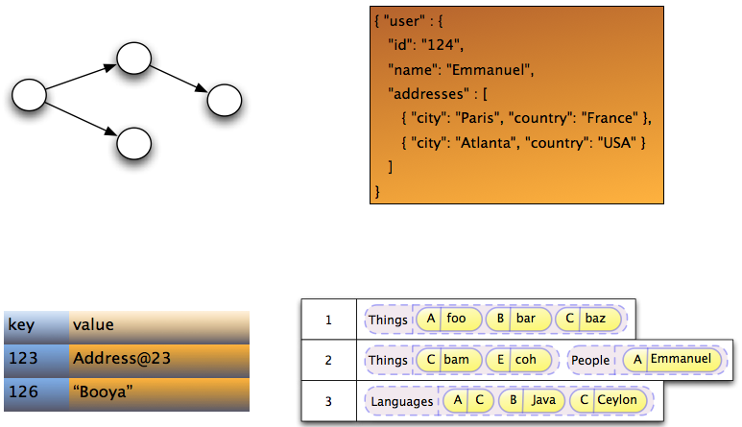
Supported types of storages
Notes:
You see the image from project documentation. It demonstrates that the world of NoSQL has many kinds of storing.

Slide 9
Supported types of storages
Graph
Document-oriented
Key-values
Column-oriented
Multi-model (produced in 5.2 release)
Notes:
The project supports graph, key-values, column-oriented and document-oriented types of storages in production version (5.1.0.Final)
The next release will support multi-model storage.

Slide 10
Supported storages
Infispinian, Ehcache, Redis(Experimental), Apache Ignite (include to release 5.2)
MongoDB, CouchDB(Experimental)
Neo4j
Cassandra(experimental)
OrientDB (include to release 5.2)
Notes:
This slide contains the enumeration of supported storages. The storages selected by italic is included to release 5.2 plan.
A part of storages has status “experimental”.

Slide 11
Supported features
Data storage | Features
 | Associations | Queries | Transactions | Remote/Embedded
Mongodb | + | Native, JPQL | Emulation | Remote
CouchDB | + | Native | Emulation | Remote
Infispinian | + | JPQL | JTA | Remote/Embedded
Ehcache | + | - | - | Remote
Redis | + | JPQL | Emulation | Remote
Neo4j | + | Native, JPQL | Emulation | Remote/Embedded
Cassandra | + | Native, JPQL | Emulation | Remote
Notes:
This slide contains aggregated information about features for each storage.
Look at the column Assiations. All integration modules supports all types of associations in JPA 2.1 It “One-To-One”, “Many-To-Many” and so on.
Look at the column Queries. A part of storages supports JPQL. The feature is implemented by Hibernate Search product.
Look at the column Transactions. The most of storages support transactions by emulation. A part of them has its own transaction system. And Hibernate OGM integrates transaction system of storage with the standard transaction system (JTA). Other part of storages has not any transactions. In this case, Hibernate OGM emulates the transaction by side tools.
Look at the column Remote / Embedded. A part of integration modules supports embedded mode. For example, Neo4j.

Slide 12
Architecture
em.getTransaction().begin();
em.persist(new Person("name1"));
em.getTransaction().commit();
Hibernate ORM Core
Hibernate OGM Core
4.commit()
3.insertTuple()
2.createTuple()
1.begin()
Hibernate OGM Module for Concrete Storage
GridDialect
DatastorageProvider
Notes:
It’s time to talk about architecture. Project Hibernate OGM (Object-Grid Mapping) is based on famous Hibernate ORM (Object-Relational Mapping).
What happens when we execute the simple code?
The core of Hibernate ORM defines type of request and redirects the request to core of Hibernate OGM. Then, the core of Hibernate OGM loads concrete provider and sends it a sequence of commands of a lower level. These commands are:
To create a new transaction
To create an empty tuple for future entity
To set data of new entity and to insert to storage
To commit the transaction.
Then concrete data storage provider and grid dialect do low-level actions with the storage.
The demonstrated sequence is right for OrientDB integration module. Integration modules for other storages can have another sequence.

Slide 13

OrientDB presentation

Slide 14
OrientDB advantages
Developed by Java
Multi-model (document + graph) storage
SQL-like query language
Supports stored procedures (any JSR-223 language)
Multi-master replication
Part of table (cluster, index and global record id) as target for query
Excellent performance (10x faster Neo4j)
Join-less retrieving of relationships
API for many languages and frameworks
Supports own transactions
Notes:
OrientDB is a multi-model database. It combines document-oriented and graph storages. In this way, you can create a document as graph node (vertex) and you can make link (edge) to other graph node. The first release of OrientDB was in 2010 by Luca Garulli.
OrientDB has advantages

Slide 15
OrientDB disadvantages
Small team
Implementation is enough green (snapshot release: 3.0.0)
Notes:
What about OrientDB disadvantages?
OrientDB team isn’t big and it can not develop new features and fix bugs quickly.
This implementation is green enough. It needs to be developed and improved.

Slide 16
Integration module for Hibernate OGM presentation

Slide 17
First release supports
Embedded and remote modes
Document model
Transactions by emulation
Associations ( one-to-one, one-to-many, many-to-many )
Embedded objects ( limitedly )

Slide 18
Plans for future releases
Using @RID as primary key for best performance
Graph model
Embedded objects as primary keys
Migration to OrientDB 3

Slide 19
THANK
YOU

Slide 20




CONTACT ME
Sergey_Chernolyas@epam.com
sergey.chernolyas
schernolyas

